Slide 1

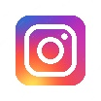
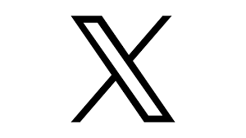


Own Social Media: On Instagram, Hunza G has a healthy audience-base; scope to improve posting frequency and reach on other platforms
overall_0_132163348573585461 columns_1_131720850809173776 56_1_131943516557675237 58_1_132071467640101448 12_0_132156153700703527 39_0_132163348565702811 18_1_132392033990359561 11_1_132428431922747730 14_1_132392033898413052 21_1_132392040552860132 26_1_132392040586007368
Social media
25_84 5_84 65_84 66_84 67_84 68_84 69_84 70_84 71_84 72_84 73_84 74_84 58_84 76_84
 | Zimmermann | MC2 Saint Barth | Seafolly | Hunza G | Melissa Odabash | Eres | Oseree | Reina Olga | Bond Eye
Audience (K) | 627 | 181 | 229 | 2 | 70 | 98 | 4 | 6 | 3
Activity | 353 | 9 | 415 | 119 | 10 | 109 | 97 | 669 | 4
Engagement (K) | 414 | 1 | 11 | 1 | 0.2 | 2 | 0.2 | 5 | 0.03
Engagement Rate (per post per 10K) | 19 | 8 | 1 | 30 | 2 | 2 | 6 | 12 | 24
Audience (K) | 3721 | 392 | 522 | 440 | 272 | 207 | 251 | 216 | 198
Activity | 472 | 372 | 464 | 310 | 502 | 225 | 307 | 689 | 390
Engagement (K) | 4181 | 120 | 113 | 163 | 320 | 118 | 84 | 974 | 91
Engagement Rate (per post per 10K) | 24 | 8 | 5 | 12 | 23 | 25 | 11 | 65 | 12
Audience (K) | 22 | 1 | 7 | Does not have X | 30 | Do not have X | - | - | -
Activity | 253 | 0 | 0 | - | 0 | - | - | - | -
Engagement (K) | 5 | - | - | - | - | - | - | - | -
Engagement Rate (per post per 10K) | 10 | - | - | - | - | - | - | - | -
Audience (K) | 15 | 0.1 | 2 | 0.002 | 0.1 | 2 | 0.1 | 0.01 | 0.1
Activity | 10 | 4 | 13 | 1 | 1 | 9 | 10 | 0 | 19
Engagement (K) | 16 | 0.001 | 0 | 0.003 | 0.01 | 0.1 | 0.1 | - | 0.2
Engagement Rate (per post per 10K) | 1076 | 36 | 25 | 15000 | 1970 | 63 | 1090 | - | 871
Audience (K) | 17 | 951 | 2 | 2 | 4 | Does not have TikTok | 4 | 35 | 9
Activity | 17 | 69 | 6 | 109 | 68 | - | 12 | 7 | 75
Engagement (K) | 79 | 994 | 0.04 | 4 | 10 | - | 3 | 10 | 16
Engagement Rate (per post per 10K) | 2681 | 152 | 46 | 242 | 358 | - | 711 | 419 | 251
Diversified brand beyond just swimwear
High frequency of posts featuring the products
Facebook
Instagram
X (Twitter)
YouTube
Thematic videos (holidays, festive season) + videos featuring the latest collection and influencers
TikTok
Source: FanpageKarma; Audience as on Dec 31, 2023; Activity and Engagement for the last 12 months; Jan’23-Dec’23; Note: Engagement rate per post per 10K audience calculated as (Engagement / Activity / Audience) * 10K

Slide 2

Social media ads (FB/IG): Hunza G significantly more active vs. competitors; scope to diversify the creatives’ style/format
Social media
ads
DIRECTIONAL
Hunza G and Zimmermann lead in # of ads; >90% of Hunza’s ads in static format
Commentary
Hunza G positioned #2 on # of ads with ~336 ads in LTM, Zimmermann leads with ~451 ads
Zimmerman advertises across a spectrum of its diverse offerings including accessories (jewelry), dress and eyewear.
Scope for Hunza G to strategize campaigns by advertising a few of its other product lines such as clothing, accessories, and kids' and maternity collections.
Hunza G depends heavily on static format (~94%) with only ~6% being video ads.
Scope to focus on video ads which offer story-telling opportunity to engage with the audience and consequently lead to improved conversion rates.
Scope for Hunza G to incorporate carousel ads in ad campaigns as a method to showcase product offerings and features across collection.
Carousel ads features multiple scrollable pictures that lead the user to different landing pages, helping in increasing click-through-rates
Source: Meta Ads Library

Slide 3

Social media ads (FB/IG): In the UK too, Hunza G doing more ads vs. competition
Social media
ads
DIRECTIONAL
Hunza G behind only Zimmermann; MC2 Saint Barth competes closely
Commentary
Hunza G positioned #2 on # of ads with ~336 ads in LTM, Zimmermann leads with ~451 ads
Zimmerman advertises across a spectrum of its diverse offerings including accessories (jewelry), dress and eyewear.
Scope for Hunza G to strategize campaigns by advertising a few of its other product lines such as clothing, accessories, and kids' and maternity collections.
Hunza G depends heavily on static format (~94%) with only ~6% being video ads.
Scope to focus on video ads which offer story-telling opportunity to engage with the audience and consequently lead to improved conversion rates.
Scope for Hunza G to incorporate carousel ads in ad campaigns as a method to showcase product offerings and features across collection.
Carousel ads features multiple scrollable pictures that lead the user to different landing pages, helping in increasing click-through-rates
Note: No ads by Eres and Bond Eye in the UK
Source: Meta Ads Library

Slide 4
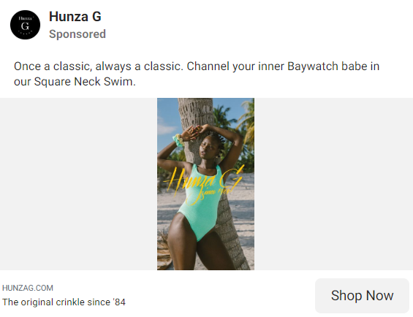
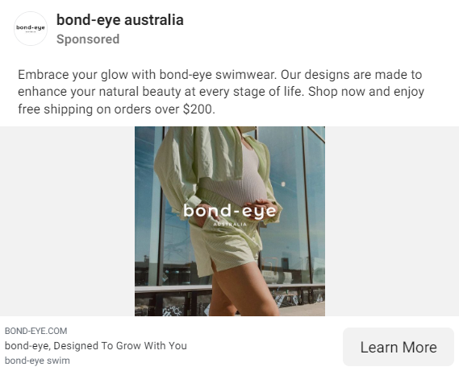
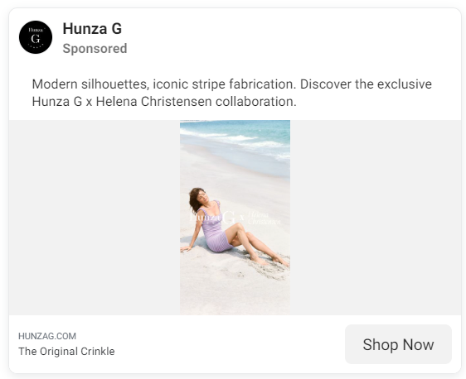
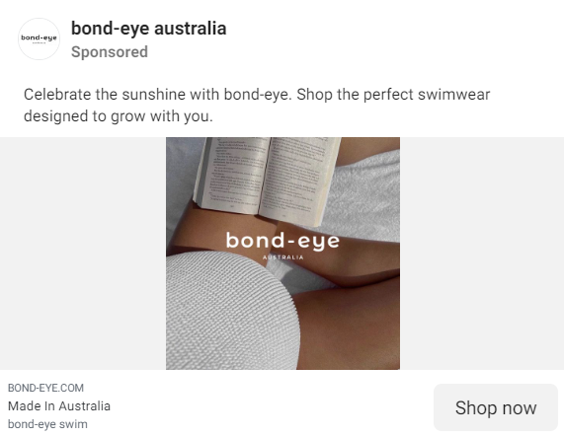
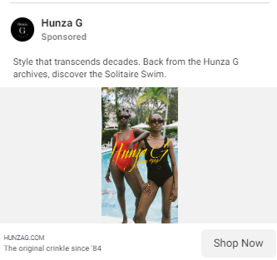
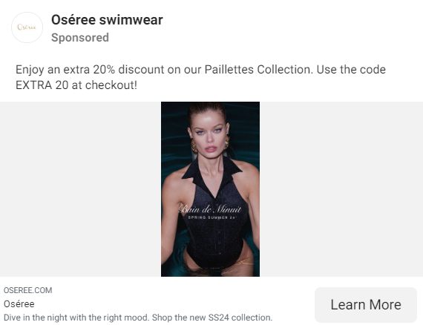
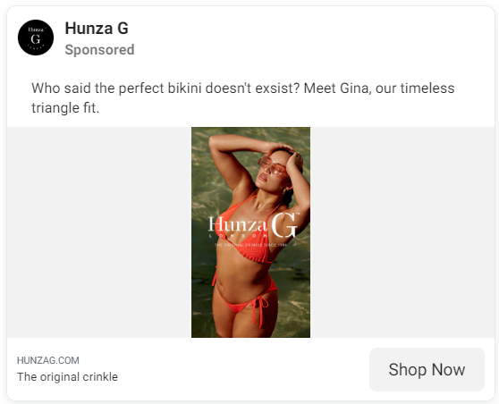
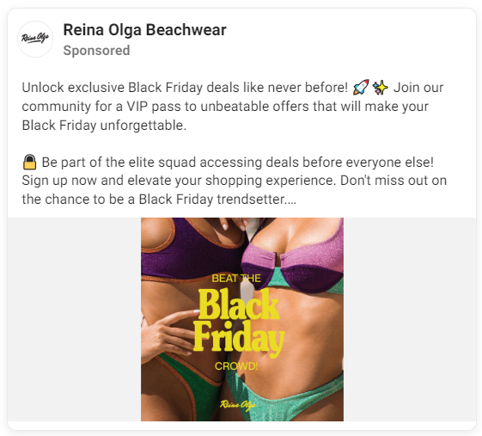
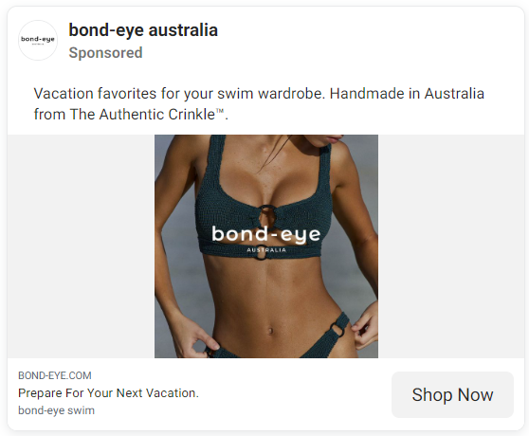
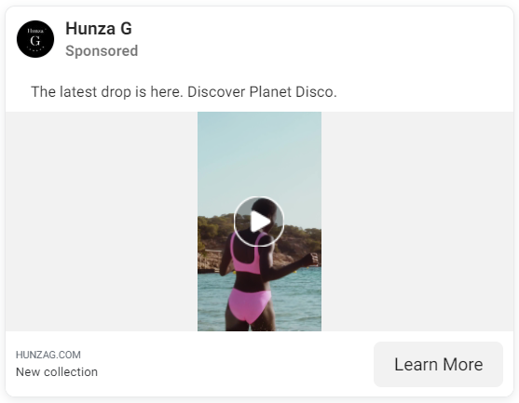
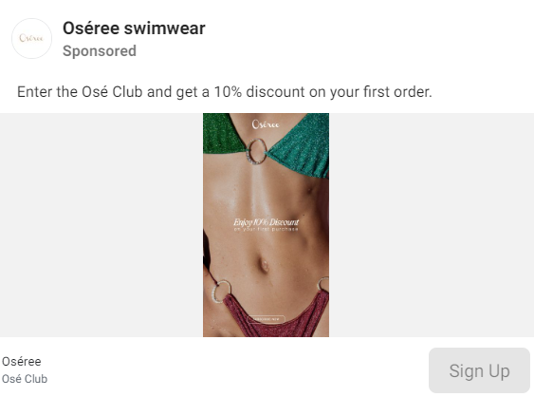
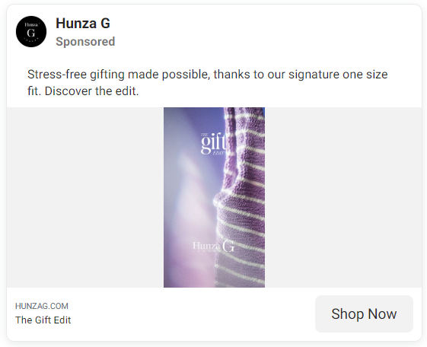
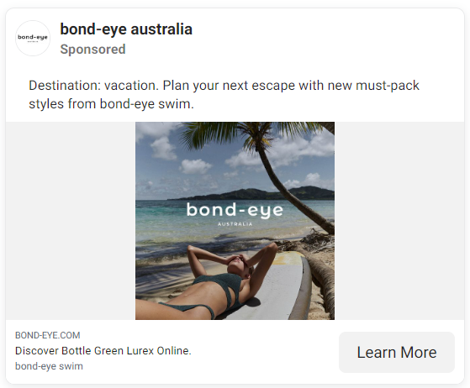
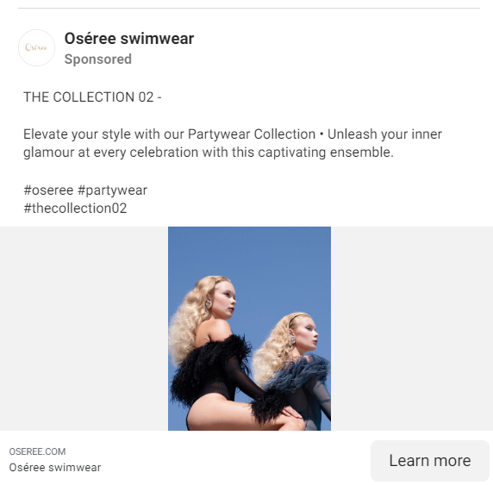
Creative quality: Good quality ads with appealing visuals & clear messaging; scope to target the ads better (occasions/ customer segments), mention any offers/ discounts (1/2)
Social media
ads
Key Criteria | Description | Hunza G | Best practices/ Competitor Examples
Emotion | Does the creative focus on evoking emotion? | Effectively uses creatives to capture viewer attention and associability/ nostalgia; for e.g.- Hunza G promoted a product by linking it to a 1990 American TV series- “Channel your inner Baywatch babe in our Square Neck Swim” Creatives highlight exclusivity by collaborations with models/ brands like Helena Christensen, Rose Inc. Ads also invoke a sense of rememberability and belonging by highlighting it’s 40-year long presence through captions like “Style that transcends decades. Back from the Hunza G archives, discover the Solitaire Swim” | Bond Eye attempts at building an emotional connect that helps in creating a strong brand USP, new product launches and memorability; for e.g.- The brand rolled out an ad communicating “Designs made to enhance natural beauty at every stage of life” showcasing a pregnant woman
Understandable | Is the brand / product message easy and clear to understand? Does the creative include visible / clear call to actions? Does the message clearly bring the brand proposition to life? | Short & crisp descriptions with scope to increase customer interest by adding additional details such as material, sale, discounts, etc., in the description Easy-to-understand language and call-to-action present at the bottom of every ad Most creatives focused on products/ collection lines; Scope to bring out the brand proposition more clearly by including more creatives talking about the overall brand in general. Opportunity to play on the longevity of the brand, unique material used, etc. | Oseree & Reina Olga highlight additional details such as discounts, launch dates, etc., in the description itself Many brands use creatives to bring out the overall brand proposition quite well; for e.g.- Bond Eye released ads communicating “handmade in Australia” & Oseree posted ads highlighting “Enter the Ose Club and get 10% discount on your first order” to initiate customer action
Relevant | Does the creative reflect the prioritised category entry points? Is the creative relevant to different types of audiences or does the brand leverage a one size fits all approach (shows lack of digital maturity)? | Most creatives don’t look to cater to any specific demographic category for women; Scope to improve advertisements by structuring the content to appeal to different categories such as people planning a vacation, maternity products, etc. A few posts highlight “one-size-fit” feature of the brand in creatives to appeal to different demographics by body type. Potentially increase this ad frequency | Bond Eye has strong creative content that highlights use-cases of their products; for e.g.- it posted “plan your next escape with new must-pack styles” to appeal to and engage people planning a vacation Similarly, Oseree also released a post highlighting its partywear swimwear collection
Source: Meta Ads Library accessed on January 11, 2024

Slide 5
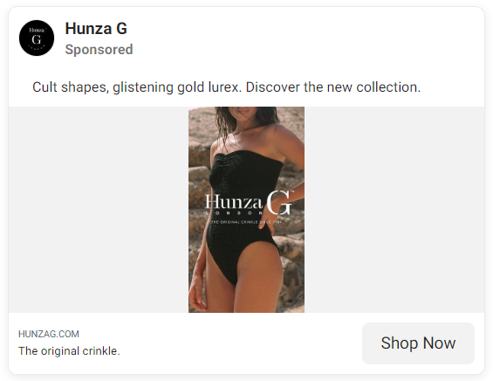
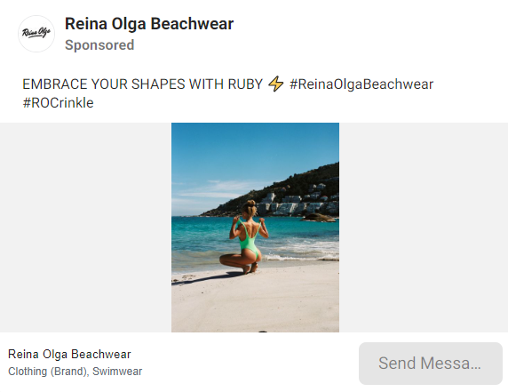
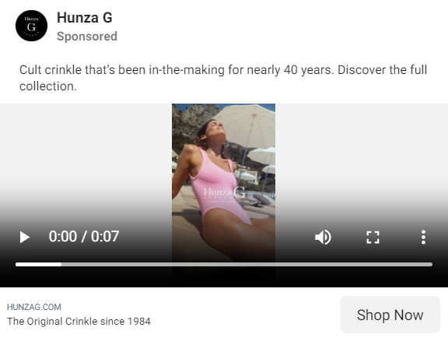
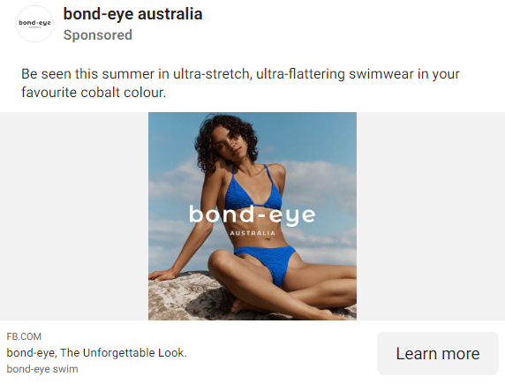
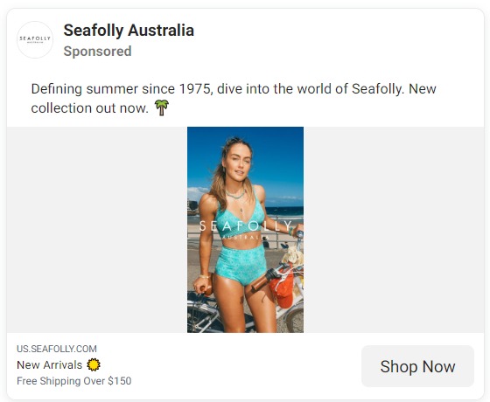
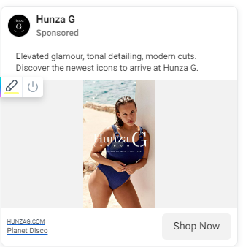
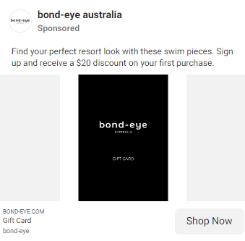
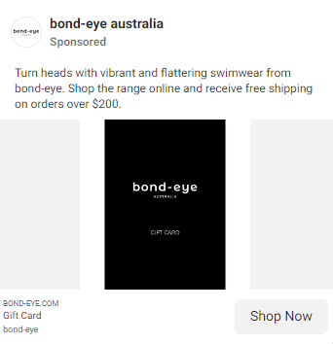
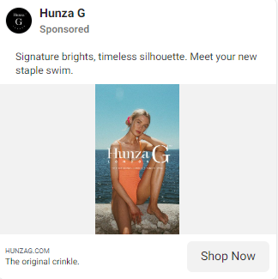
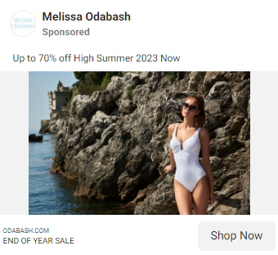
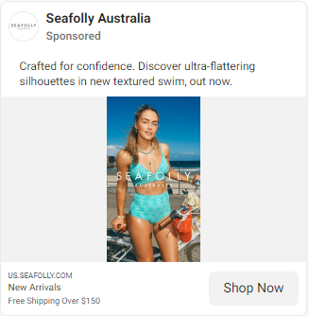
Creative quality: Good quality ads with appealing visuals & clear messaging; scope to target the ads better (occasions/ customer segments), mention any offers/ discounts (2/2)
Social media
ads
Key Criteria | Description | Hunza G | Best practices/ Competitor Examples
Distinctive | Does the creative leverage the brand’s distinctive assets well (e.g. branding appears across assets in first few seconds of video)? Are distinctive assets (e.g. logo, tagline, characters) applied consistently? | Creatives leveraging the brand’s distinctive assets like brand logo, font style, etc. well with consistent use of their logo and tagline (“The original crinkle since 1984”) throughout all advertisements Audio/Visual creatives bring out brand name in the beginning of the video along with similar template being published across ads, increasing brand recall Ads highlight brand’s appeal, font & colors distinctively | Reina Olga consistently adds brand hashtags such as “#ReinaOlgaBeachwear” and “#ROCrinkle” in their description which helps in creating strong brand recall Other brands like Bond Eye and Seafolly also display consistent use of the brand assets such as logo throughout their creatives
Optimised | Is creative leveraged optimised for the consumers across the funnel and the screens they view on? Does the brand have relevant creative across all stages of the funnel e.g. awareness, consideration, purchase? | Ads are optimized for both mobile & desktop platforms Majority of creatives have emphasized specific products or collection lines, highlighting colors, cuts, and design of the swimwear; Scope to highlight broader messaging/brand proposition/overall brand story in ads Creatives are relevant across all stages of the sales funnel as Hunza G’s have eye-catching visuals that spark interest among top funnel consumers, along with one size fits all claims which helps with product differentiation and make ads more persuasive. Call to action button on almost each ads in consumer conversions Hunza G can look to convert customers and create a powerful purchase push by highlighting the discounts / offers whenever sales or offers are live on the website | Bond-Eye and Melissa Odabash have product ads highlighting discounts / offers and freebies to add a powerful purchase push for consumers across sales funnel Seafolly incorporates phrases like “Crafted for Confidence” in its creatives that help establish an emotional connect with consumers and conveys brand’s commitment to inclusivity, body positivity and female empowerment
Source: Meta Ads Library accessed on January 11, 2024

Slide 6



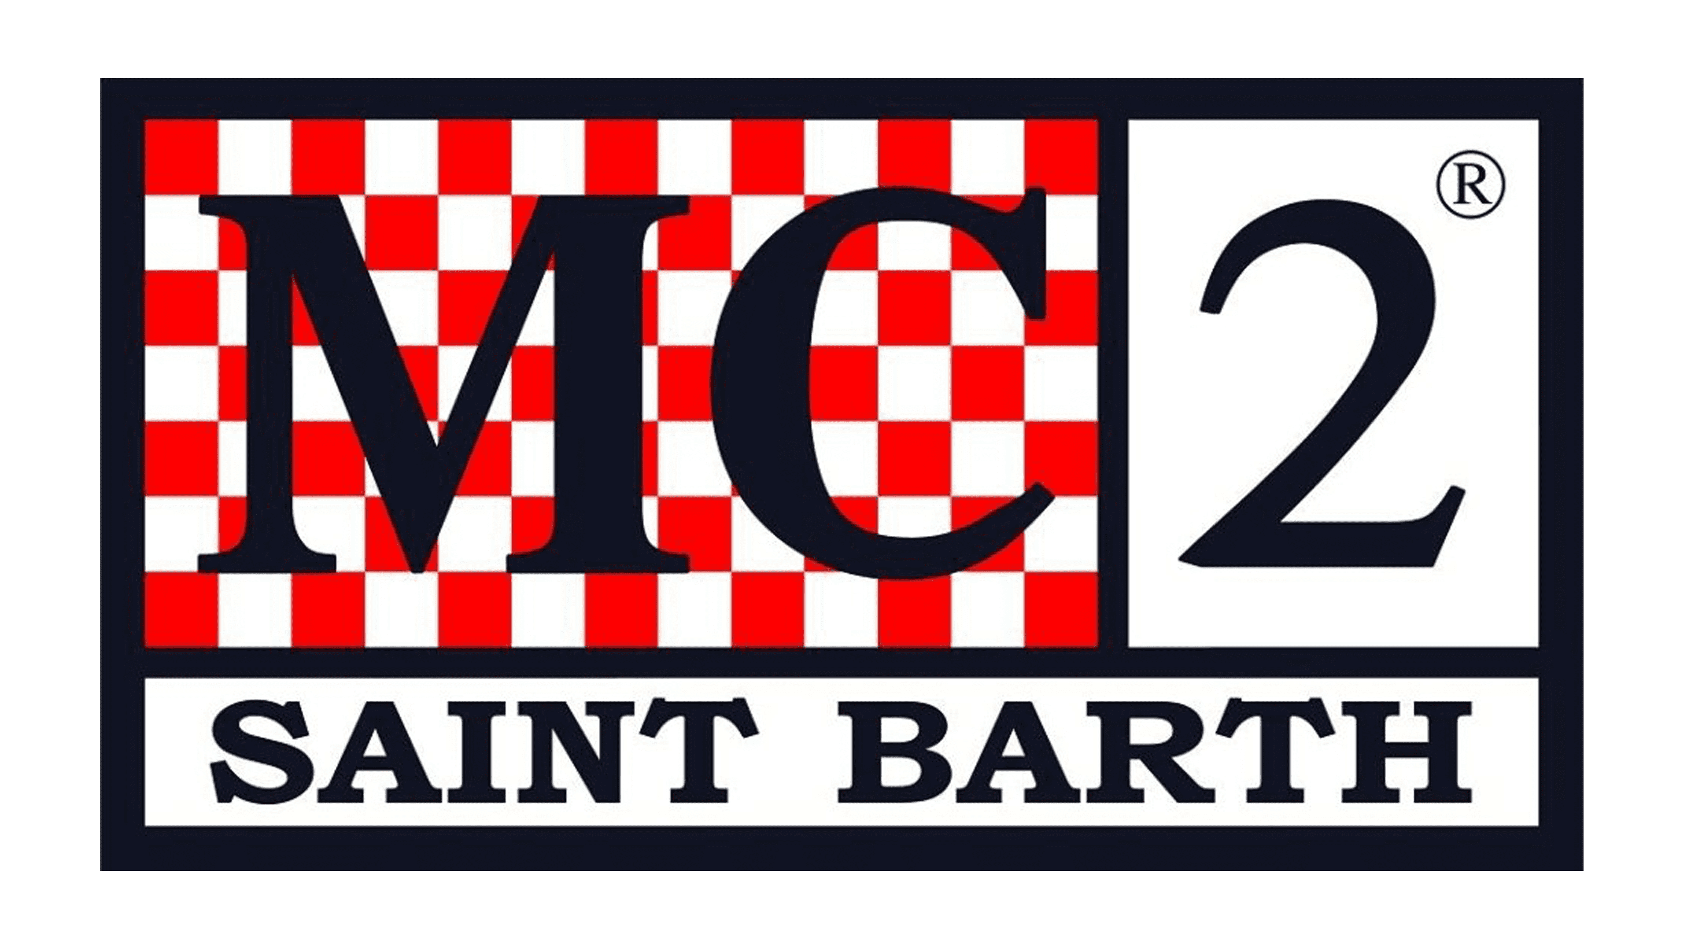
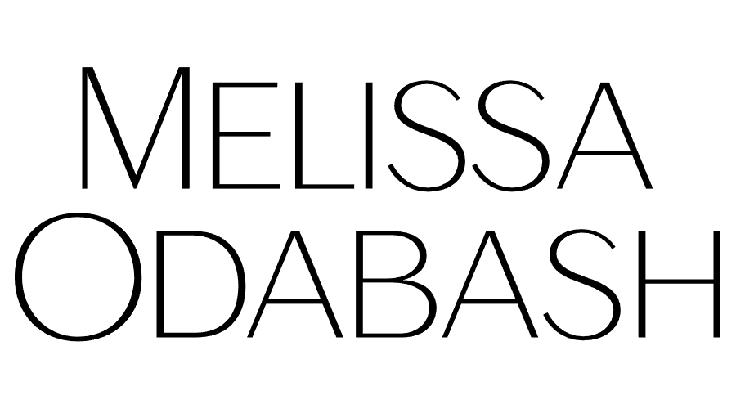


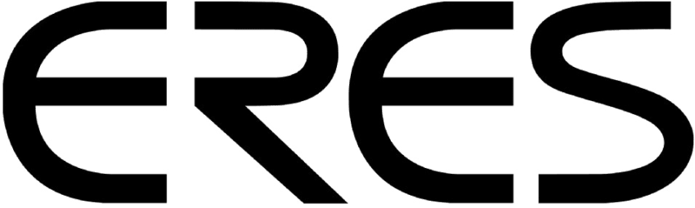
Influencer marketing: Hunza G has the highest # of influencers vs. pure-play swimwear brands, however, lags slightly on ‘engagement rate’ on influencer content
Influencer marketing
Zimmermann - Diversified brand beyond just swimwear
Instagram
Influencers | Users with more than 1,000 followers, who mentioned the brand | 383 | 1600 | 146 | 134 | 115 | 113 | 100 | 94 | 45
Sponsored influencers | Influencers whose posts had any of the “sponsored content” characteristics^ | 79 (21%) | 387 (24%) | 42 (29%) | 43 (32%) | 73 (64%) | 25 (22%) | 29 (29%) | 43 (46%) | 17 (38%)
Mega and Macro tier | Mega: 1M+ followers, Macro: 500K to 1M followers | 6.5% | 5.7% | 8.2% | 2.3% | 0.9% | 9.8% | 10.0% | 2.2% | 6.7%
Intermediate tier | Influencers with 50K to 500K followers | 19.6% | 19.9% | 27.4% | 17.2% | 11.3% | 27.4% | 29.0% | 23.4% | 17.8%
Micro and Nano tier | Micro: 10K to 50K followers, Nano: 1K to 10K followers | 73.9% | 74.4% | 64.4% | 80.6% | 87.8% | 62.9% | 61.0% | 74.5% | 75.5%
Total Audience | Cumulative follower-base of influencer accounts (M) | 90 | 371 | 23 | 8 | 4 | 41 | 13 | 11 | 9
Est. reach | AI-based estimation of the number of “active” audience likely to view the posts (M) | 11.6 | 35.6 | 2.3 | 0.9 | 0.4 | 3.4 | 1.3 | 0.9 | 0.6
Total Mentions | Cumulative number of times brand name was mentioned in posts | 533 | 2700 | 199 | 183 | 289 | 154 | 181 | 125 | 57
Avg. Engagement Rate | Percent of audience who like or comment (engage) with the posts | 1.26% | 1.57% | 2.74% | 3.01% | 3.79% | 0.22% | 1.51% | 0.77% | 0.72%
Note: ^Posts marked using Instagram’s Paid Partnership Feature or having #sponsored/ #ad hashtags in caption Source: HypeAuditor, last 12 months data (Jan’23-Dec’23)

Slide 7
Scope for Hunza G to work more with nano and micro tier influencers – these are more cost-effective and typically have a more engaged following vs. big accounts
Influencer marketing
Instagram
Cumulatively, >60% of Hunza G’s influencers post ‘lifestyle,’ ‘outfits,’ ‘family,’ and ‘beauty’ oriented content
Hanza G’s influencer tiers’ split closely mirrors that of Zimmermann with ~45% Nano influencers, followed by 28% Micro & 20% Mid
Similar audience demographics across brands
Note: Mega-influencers are those with >1M followers; Macro-influencers are those with 500K – 1M followers; Mid-tier influencers with 50K - 500K followers; Micro-influencers have 10K - 50K followers; Nano-influencers have 1K - 10K followers; *HypeAuditor reports top 9 category segments for a brand | Source: HypeAuditor, last 12 months data (Jan’23-Dec’23)

